Slide 1
Finding the value of Gaussian Integral

Slide 2
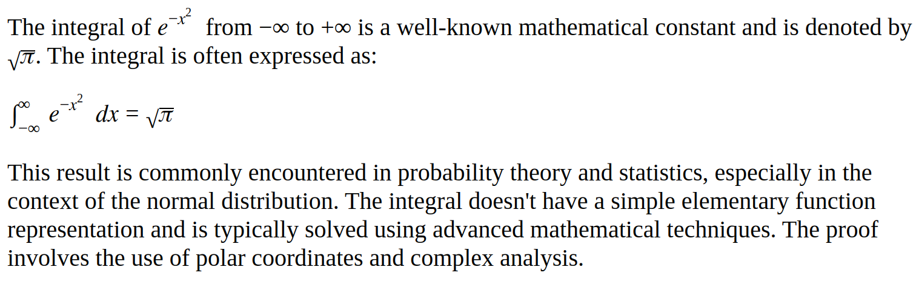
Integral of f(x) = exp(-x^2) from -infinite to +infinite
Answer from ChatGPT:

Slide 3
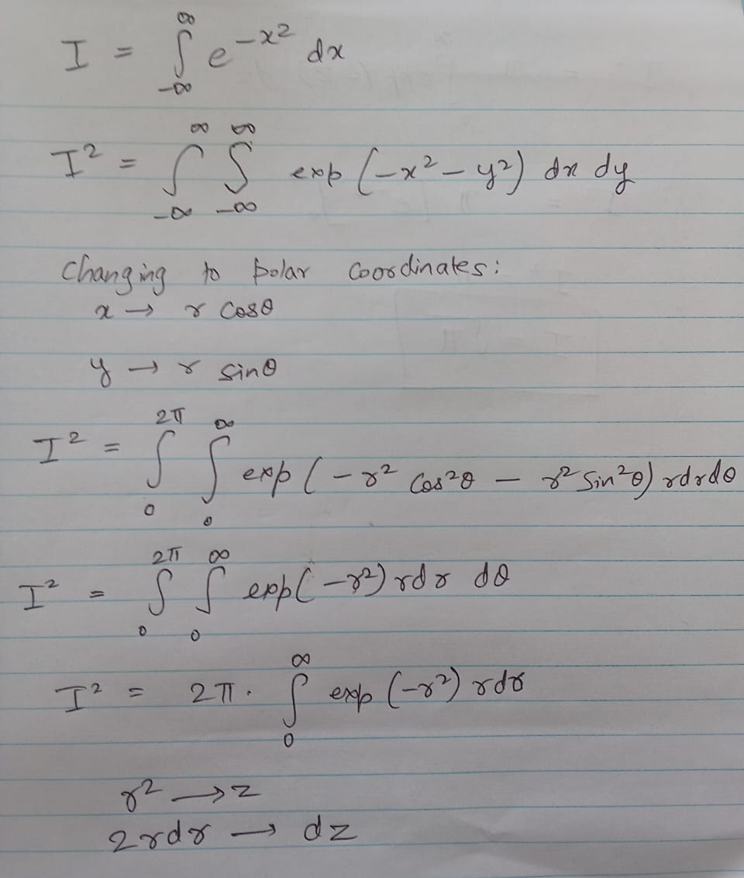
Note (1):
I = Integral of f(x) w.r.t. dx
Then I^2 = Integral of f(x).f(y) w.r.t. dxdy
Note (2): Well known step:
When changing to polar coordinates from (x, y) to (r, theta):
# (dx dy) changes to (r dr dtheta)
Note (3): Well known trigonometric property:
sq(sin(theta)) + sq(cos(theta)) = 1

Slide 4
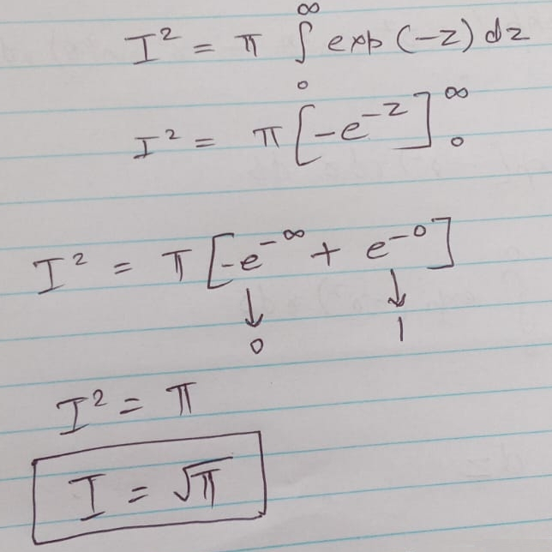
Note:
In this slide we are using a result:
(integral of e^(-x)) = -e^(-x)
This is a equation is derived from another result:
(integral of e^(x)) = e^(x)

